Slide 1
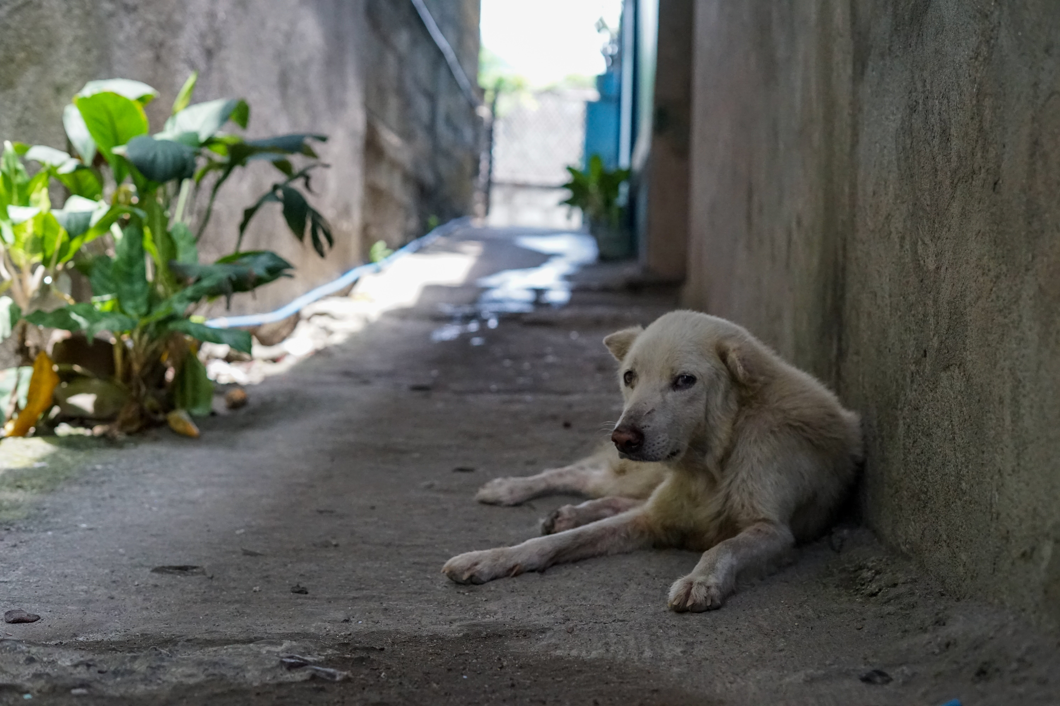

A Proposal to Investigate Three Technical Solutions to Eliminate the Hunger Problem of Stray Dogs in Erdek Umut Street
Ömer Oktay Gültekin 21901413
Department of Computer Engineering
ENG 401-12
Figure 1: A Stray Dog Picture [1]
1

Slide 2
TABLE OF CONTENTS
01
Introduction
02
Problem Definition
03
Proposed Solutions
04
Criteria for Assessing Proposed Solutions
05
Proposed Research Methodology
06
References
2

Slide 3

1. Introduction
PETS
20%
STRAY DOGS
22%
OTHER FREE RANGE DOGS
58%
World-wide Total Dog Population
900 Million
Figure 2: Distribution of the Worldwide Dog Population by Categories in 2018 [2]
3

Slide 4
1. Introduction
The country with the largest dog population in the world is in America:
Dogs: 77 Million [3]
Total Number of
Stray Animals: 70 Million [3]
3.3 million dogs enter a shelter,
Each Year [3]
2 million dogs get adopted from shelter,
670.000 dogs entering a shelter are euthanized,
4

Slide 5
1. Introduction
Turkey has approximately 10 million stray dogs, but only 250 shelters [4].
With urbanization, it has become difficult for dogs to find food, and with the food leftovers being thrown into the garbage at a height that dogs cannot reach, dogs have become dependent on humans for food [5].
Dogs can usually live without food three to five days if there is plenty of water [6].
Dogs can live a healthy life by eating every 24 hours [7].
The stable feeding system needed for the stray dogs.
5

Slide 6
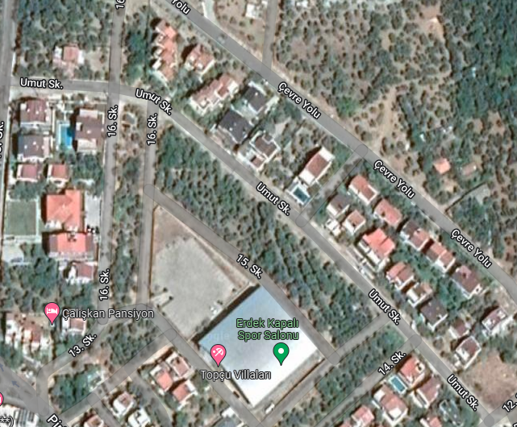

1. Introduction
The population of Erdek in winter is 32.038 [8].
The population of Erdek increases approximately 10 times during the summer months [9].
The majority of the Umut Street consist of those who come in the summer.
Approximately ten dogs live in the street.
Figure 3: Erdek Umut Street in Google Maps [10]
6

Slide 7



1. Introduction
Purpose: Establish a regular feeding system for stray dogs.
Impact: Prevent stray dogs from starving to death by ensuring they are fed regularly.
Significance: Becoming an example of shifting the responsibility of feeding street dogs from shelters to citizens to prevent the death of undernourished dogs.
7

Slide 8
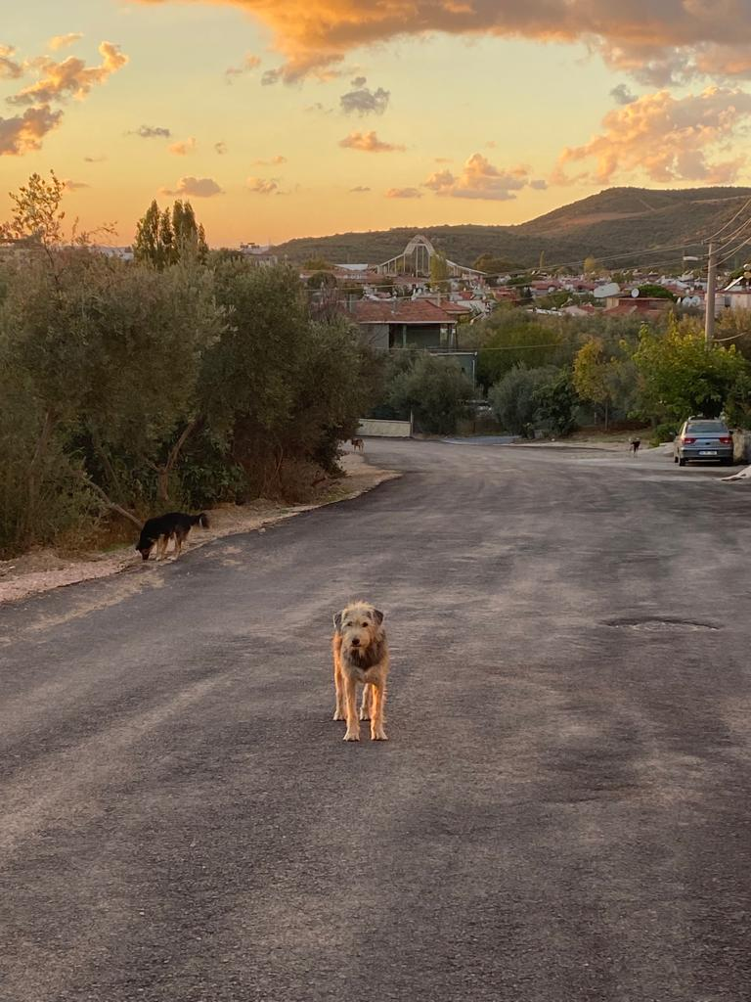
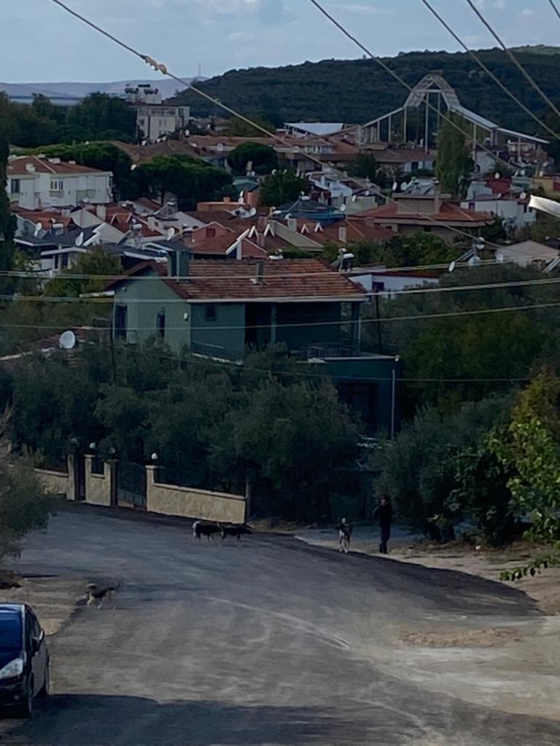
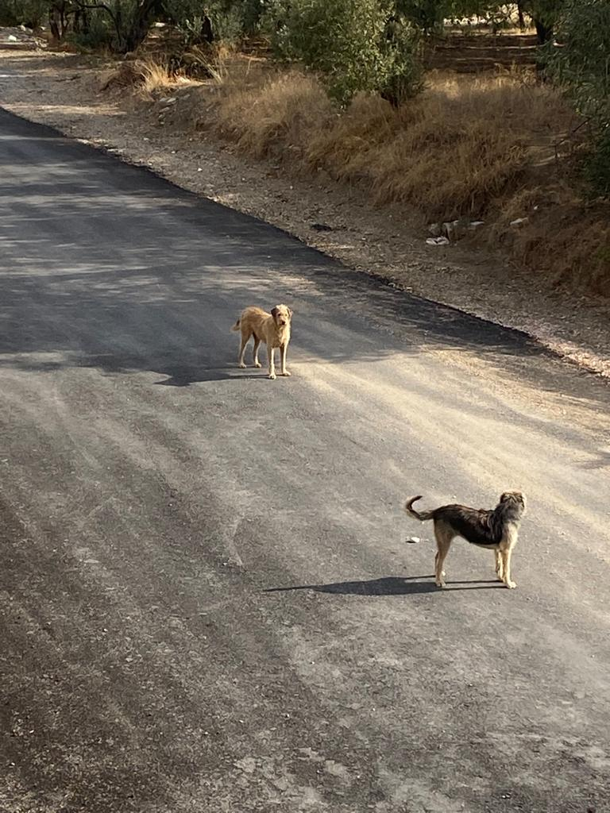
2. Problem Definition
Problem: The stray dogs in Erdek Umut Street cannot be fed regularly.
Figure 4: The Dogs Looking for Food [25]
Figure 5: A Volunteer is Giving Food to the Dogs [25]
Figure 6: The Photo of Stray Dogs [25]
8

Slide 9
2. Problem Definition
Who
Stray Dogs
What
Irregular Feeding of The Dogs
When:
Always but Especially in Winter
Where:
Erdek Umut Street
Why:
Lack of Coordination amongs the people
How:
Stray Dogs are not properly feeded
9

Slide 10
2. Problem Definition
Root Cause: Lack of Coordination Amongs the People
Lack of knowledge of whether the dogs were feeded.
Lack of containers of food and water for the animals in the street.
Very few people living in the street during the winter months.
10

Slide 11
3. Proposed Solutions
Proposed Solution 1: Designing RFID tag system to track feeding times of the dogs.
Proposed Solution 2: Bluetooth based system to track feeding times of the dogs.
Proposed Solution 3: A smart feeding machine
11

Slide 12
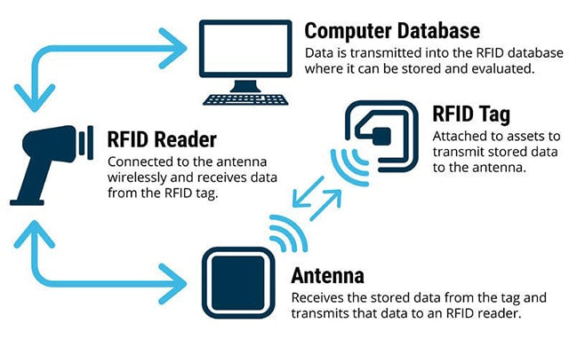
3.1 Proposed Solution 1: RFID Tag System
What is RFID?
Figure 7: RFID Tracking Down Process [11]
12

Slide 13
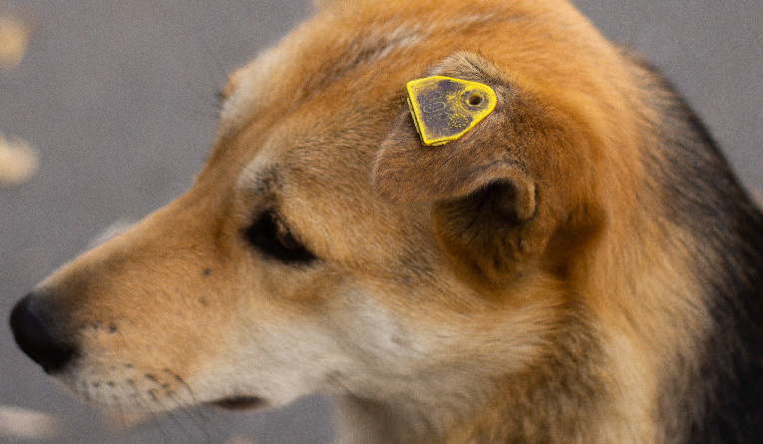

3.1 Proposed Solution 1: RFID Tag System
How will it work?
Figure 8: Dog Ear Tag [12]
Figure 9: RFID Tag Small Enough to Fit in Dog Ear Tag [13]
13

Slide 14
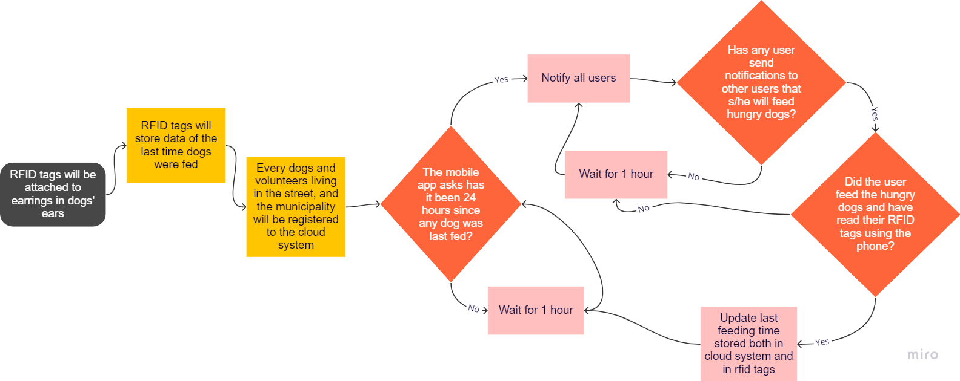
3.1 Proposed Solution 1: RFID Tag System
How will it work?
14

Slide 15
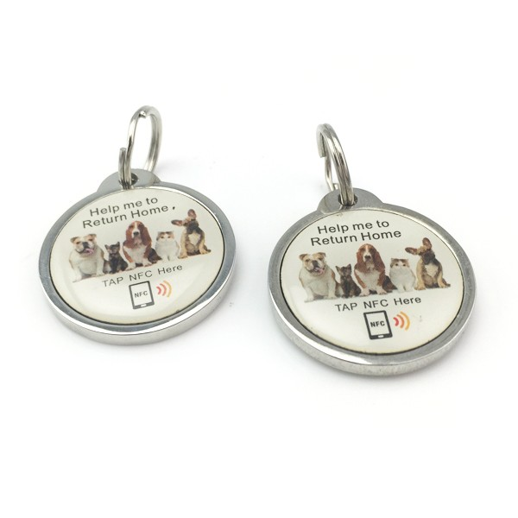
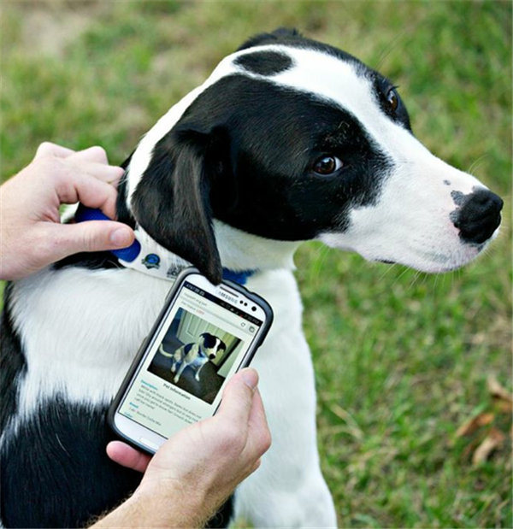
3.1 Proposed Solution 1: RFID Tag System
Similar Products:
Figure 10: Pet ID Tag [14]
Figure 11: Example Usage of ID Tag [14]
15

Slide 16
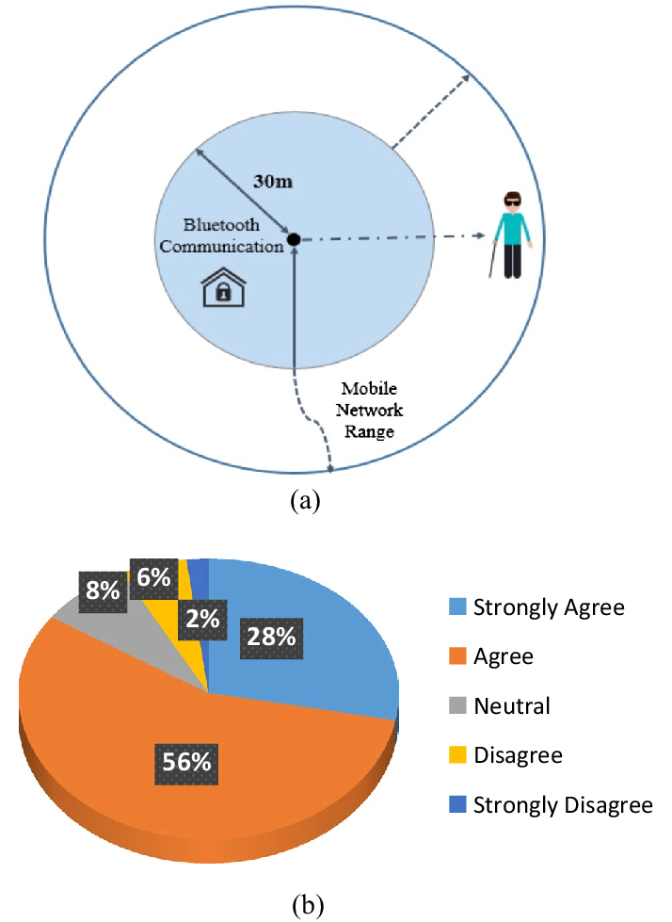
3.2 Proposed Solution 2: Bluetooth System
Advantages of Bluetooth:
Figure 12: Bluetooth Communication Range [15]
16

Slide 17
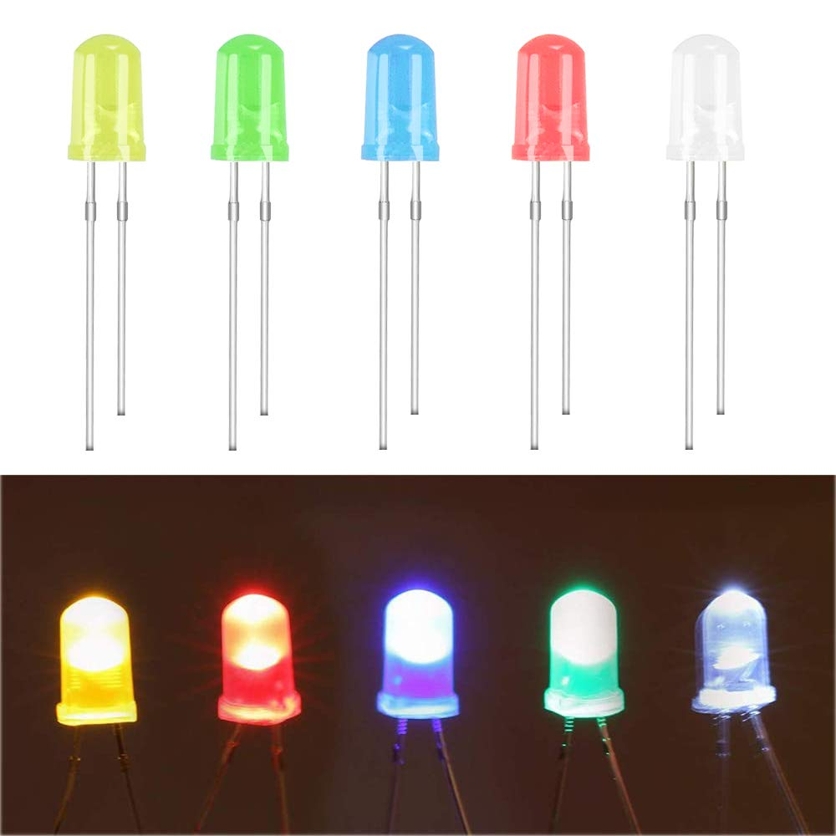
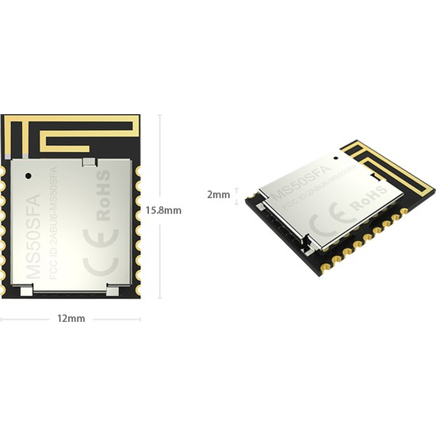
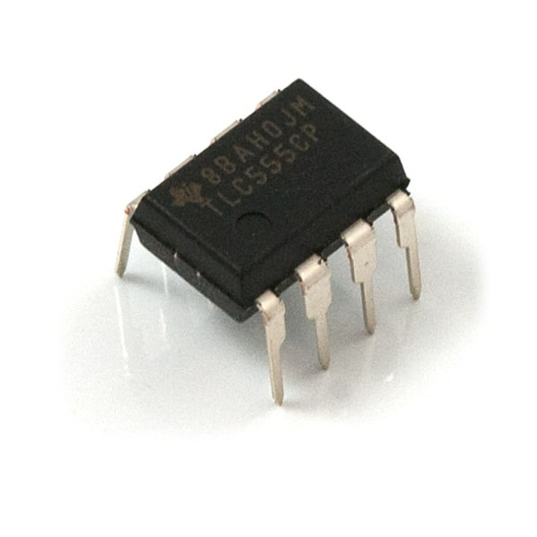
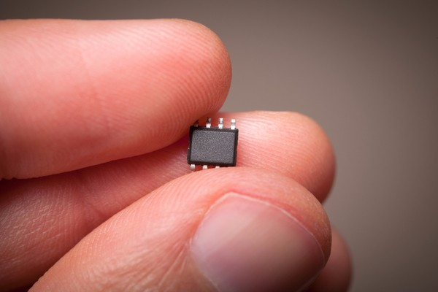
3.2 Proposed Solution 2: Bluetooth System
How will it work?
Figure 13: The NRF52832 Bluetooth Module [16]
Figure 14: An Example Microchip [17]
Figure 15: Example Led Component [18]
Figure 16: Example Timer Component [19]
17

Slide 18
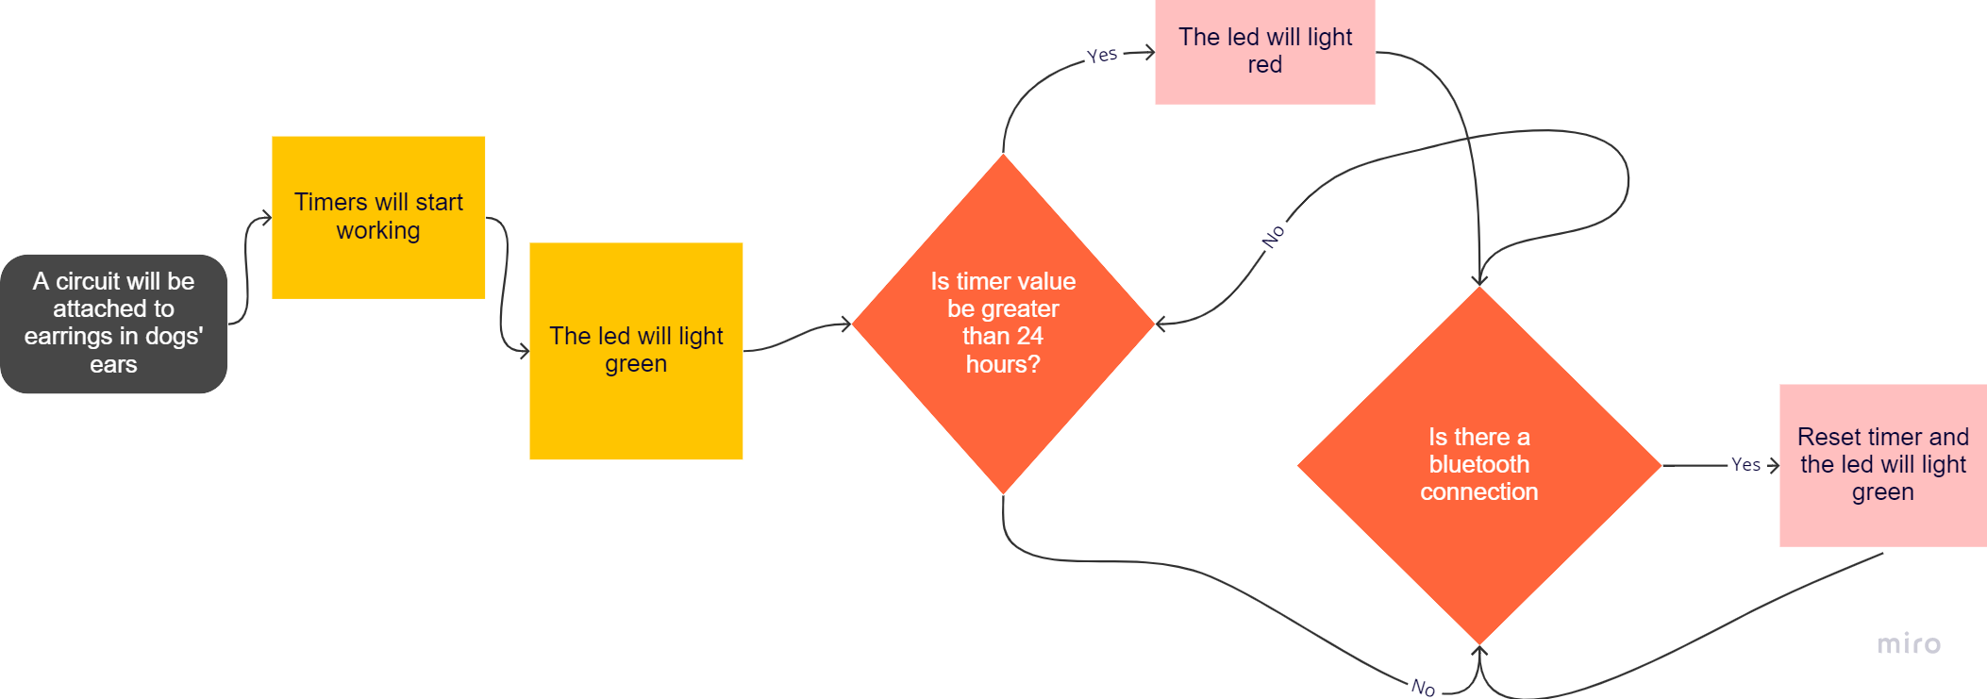
3.2 Proposed Solution 2: Bluetooth System
How will it work?
18

Slide 19

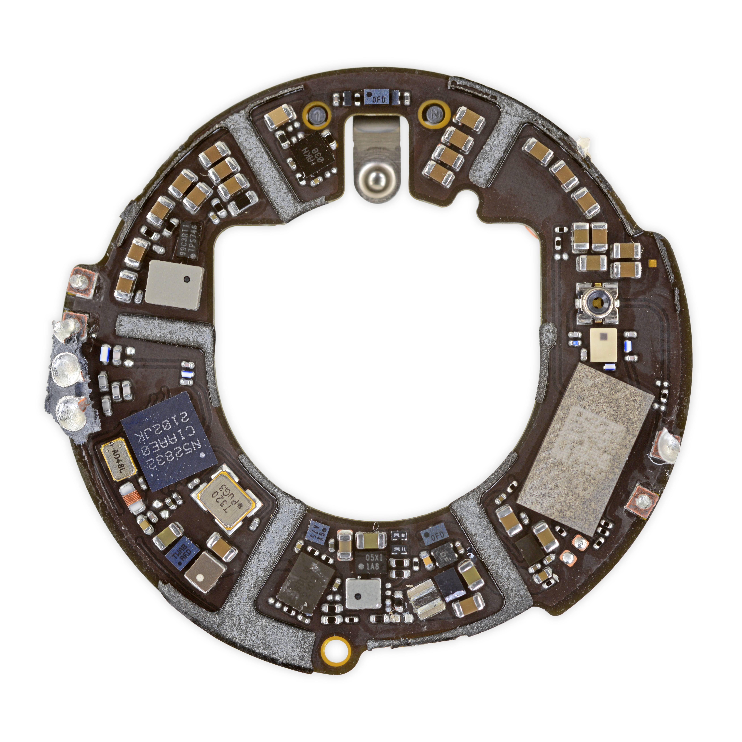
3.2 Proposed Solution 2: Bluetooth System
Similar Products:
Figure 18: Inside of Apple Airtag [21]
Figure 17: Apple Airtag [20]
19

Slide 20
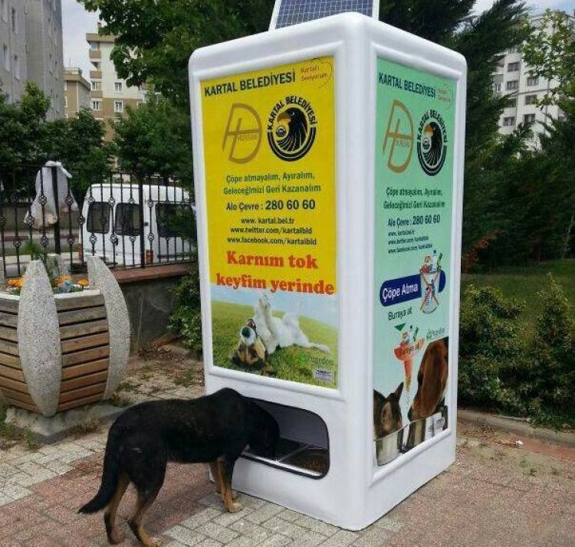
3.3 Proposed Solution 3: Smart Feeding System
Similar Products:
Figure 19: Sample Feeding Machine [22]
20

Slide 21
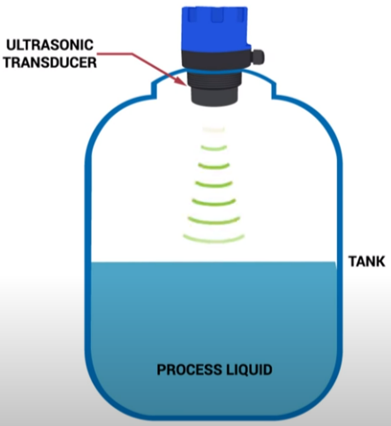
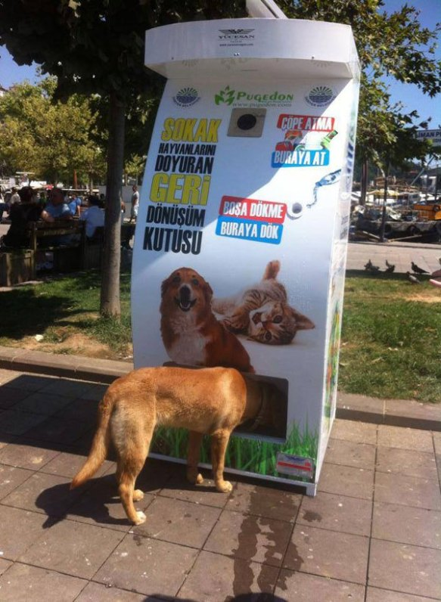
3.3 Proposed Solution 3: Smart Feeding System
How will it work?
Meal Container
Water Container
Figure 20: A System to Measure the Food or Water Amount [23]
Figure 21: The Sketch of Smart Feeding System [24]
Figure 22: Erdek Umut Street in Google Maps [10]
21

Slide 22
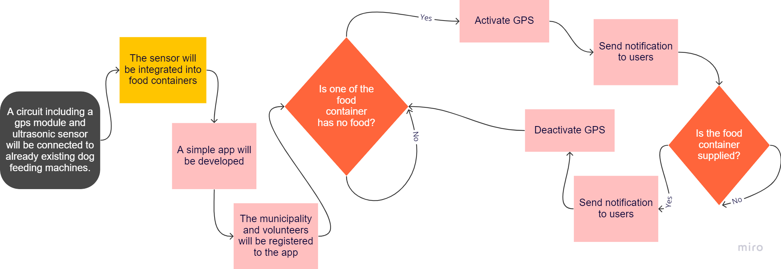
3.3 Proposed Solution 3: Smart Feeding System
How will it work?
22

Slide 23
4. Criteria for Assessing Proposed Solutions
Cost: All systems will be compared based on cost per dog.
Practicality: Each solutions will be questioned based on can volunteers use it comfortably.
Sustainability: All systems will be compared based on how many years can the solution be used.
23

Slide 24



5. Proposed Research Methodology
Market Research
Expert Opinion
Survey
24

Slide 25
5.1 Proposed Research Methodology
Market Research
This methodology will be used for comparing the costs
Survey
A survey will be conducted with the municipality and volunteers for comparing the practicality of the solutions.
25

Slide 26
5.1 Proposed Research Methodology
Expert Opinion
Hardware vendors will be consulted to understand technical capabilities of hardware to assess the sustainability of each solutions.
Mobile app developers will be consulted to take a price for developing the necessary apps the solutions needed.
Bilkent BCC employees will be consulted for how to code the RFID tags inside the Bilkent University ID cards.
26

Slide 27
6. References
[1] A. Young, White Dog Lying Beside Wall. 2019 [Online].
Available: https://unsplash.com/photos/pCJCfl5HWdA. [Accessed: 14- Oct- 2022].
[2] N. Cosgrove, "How Many Dogs Are There? (US & Worldwide Statistics 2022) | Pet Keen", Pet Keen, 2022. [Online]. Available: https://petkeen.com/how-many-dogs-are-there-statistics/.
[Accessed: 14- Oct- 2022].
[3] "How Many Pets Are In The World & The US? 71+ Pet Stats", Simply Insurance™, 2022.
[Online]. Available: https://www.simplyinsurance.com/pet-statistics/. [Accessed: 14- Oct- 2022]
[4] "4 Nisan Sokak Hayvanları Günü: Türkiye'de sokak hayvanları ne durumda ve neden tartışılıyor? –
BBC News Türkçe", BBC News Türkçe, 2022. [Online].
Available: https://www.bbc.com/turkce/haberler-turkiye-60947128. [Accessed: 14- Oct- 2022].
27

Slide 28
6. References
[5] "İçişleri Bakanlığı’ndan araştırma: ‘Sokak hayvanları tehlikeli mi?’ ‘Evet’ yüzde 34, ‘Hayır’ yüzde 45", Hurriyet.com.tr, 2022. [Online]. Available: https://www.hurriyet.com.tr/yazarlar/nedim-sener/icisleri-bakanligindan-arastirma-sokak-hayvanlari-tehlikeli-mi-evet-yuzde-34-hayir-yuzde-45-42029404. [Accessed: 14- Oct- 2022].
[6] "How to Get a Sick Dog to Eat", Drphillipsanimalhospital.com, 2022. [Online]. Available:
https://drphillipsanimalhospital.com/2020/08/31/how-to-get-a-sick-dog-to-eat/.
[Accessed: 14- Oct- 2022].
[7] "Feeding pet dogs just once a day might keep them healthier as they age", New Scientist, 2022. [Online]. Available: https://www.newscientist.com/article/2298623-feeding-pet-dogs-just-once-a-day-might-keep-them-healthier-as-they-age/. [Accessed: 14- Oct- 2022].
28

Slide 29
6. References
[8] "Balıkesir Erdek Nüfusu 2021 - 2022 | Erdek İlçesinin Yüzölçümü kaçtır?", Bölge Gündem Haber, 2022. [Online]. Available: https://www.bolgegundem.com/balikesir-erdek-nufusu-2020-2021-erdek-ilcesinin-yu zolcumu-kactir-1429462h.htm#:~:text=2021%20-%202022%20Balıkesir%20Erdek%20nüfusu, Bin%20038%20kişi%20olduğu%20açıklandı. [Accessed: 14- Oct- 2022].
[9] "Erdek sahilleri Akdeniz'i aratmıyor FOTO GALERİ", hthayat.haberturk.com, 2022. [Online]. Available: https://www.haberturk.com/ekonomi/turizm/haber/534319-erdek-sahilleri-akdenizi-aratmiyor-foto-galeri. [Accessed: 14- Oct- 2022].
[10] "Umut Sk., Erdek/Balıkesir", Google.com, 2022. [Online].
Available: https://www.google.com/maps/place/Umut+Sk.,+Erdek%2FBalıkesir/@40.4095282,27.7871197,17.75z/data=!4m5!3m4!1s0x14b42efc300f7295:0x4152942a854c004a!8m2!3d40.409539!4d27.788246. [Accessed: 14- Oct- 2022].
29

Slide 30
6. References
[11] "What Is RFID Technology and How Can I Use It?", Shopify, 2022. [Online]. Available: https://www.shopify.com/retail/rfid-technology. [Accessed: 14- Oct- 2022].
[12] "Marking Street Dogs – Parsemus Foundation", Parsemus Foundation, 2022. [Online]. Available: https://www.parsemus.org/pethealth/marking-street-dogs/. [Accessed: 14- Oct- 2022].
[13] "Buy 13.56Mhz NFC Sticker/Tag - ISO14443A, Ntag 213, 25mm with cheap price", https://www.robotistan.com/, 2022. [Online]. Available: https://www.robotistan.com/1356mhz-nfc-etiket-iso14443a-ntag-213-25mm. [Accessed: 14- Oct- 2022].
[14] "Smart Touch Nfc Ntag213/ntag216 Chip Unit Qr Code Finds Pet Id Tag Funny Collar Anti-lost Pet Epoxy Tag For Cat Dog - Buy Smart Touch Nfc Unit Qr Code Finds Pet Id Tag Funny Collar Anti-lost Pet Epoxy Tag For Cat Dog,Nfc Tag,Id Tag Product on Alibaba.com", Alibaba.com, 2022. [Online]. Available: https://www.alibaba.com/product-detail/Nfc-Chip-Tag-Nfc-Rfid-Tags_60841583620.html. [Accessed: 14- Oct- 2022].
30

Slide 31
6. References
[15] W. Rahman, R. Islam, M. Hasan and S. Mia, "IoT Based Smart Assistant for Blind Person and Smart Home Using the Bengali Language", Springer Nature, 2020 [Online]. Available: https://www.researchgate.net/publication/344219052_IoT_Based_Smart_Assistant_for_Blind_Person_and_Smart_Home_Using_the_Bengali_Language. [Accessed: 14- Oct- 2022].
[16] "Minew MS50SFA NRF52832 Low Energy 5.0 Bluetooth Modülü", hepsiburada, 2022. [Online]. Available: https://www.hepsiburada.com/minew-ms50sfa-nrf52832-low-energy-5-0-bluetooth-modulu-pm-HBC0000132PZD. [Accessed: 14- Oct- 2022].
[17] K. Levermore, "A brief history of the microchip - Dialogue Review", Dialogue Review, 2022. [Online]. Available: https://dialoguereview.com/brief-history-microchip/. [Accessed: 14- Oct- 2022].
[18] "(100 Pcs) MCIGICM 5mm LED Light Diodes, LED Circuit Assorted Kit for Science Project Experiment (Multi-Colored - 5 Color)", Amazon.com, 2022. [Online]. Available: https://www.amazon.com/MCIGICM-Circuit-Assorted-Science-Experiment/dp/B07PG84V17. [Accessed: 14- Oct- 2022].
31

Slide 32
6. References
[19] "555 Timer IC - DIP-8", Proto-PIC, 2022. [Online]. Available: https://proto-pic.co.uk/product/555-timer-ic. [Accessed: 14- Oct- 2022].
[20] "AirTag", Apple (Türkiye), 2022. [Online]. Available: https://www.apple.com/tr/airtag/. [Accessed: 14- Oct- 2022].
[21] "AirTag Teardown: Yeah, This Tracks", IFIXIT, 2022. [Online]. Available: https://www.ifixit.com/News/50145/airtag-teardown-part-one-yeah-this-tracks. [Accessed: 14- Oct- 2022].
[22] "Vending Machine for Stray Dogs", The Bark, 2022. [Online]. Available: https://thebark.com/content/vending-machine-stray-dogs. [Accessed: 14- Oct- 2022].
[23] OMEGA Engineering, Water Level Sensor Types and how they work!. 2022 [Online]. Available: https://www.youtube.com/watch?v=bHxEXlIHSHY. [Accessed: 14- Oct- 2022].
32

Slide 33
6. References
[24] "machine feeding strays – Fascinating Animals", Fascinating Animals, 2022. [Online]. Available: https://facinatingamazinganimals.wordpress.com/tag/machine-feeding-strays/. [Accessed: 14- Oct- 2022].
[25] E. Gültekin, A Stray Dog. 2022.
[26] Elevated view of straight and curve road in forest. 2022 [Online]. Available: https://www.freepik.com/free-photo/elevated-view-straight-curve-road-forest_2579789.htm#query=top%20view%20road%20forest&position=3&from_view=keyword. [Accessed: 14- Oct- 2022].
33

Slide 34

THANKS
FOR
LISTENING!
Figure 23: A Representation of the Three Solution [26]
34

